Slide 1
Hi Presenter! Read Me Before Using!
This webinar resource is almost ready for you to use! Be sure to:
  Look through and add custom information
    Slide 2- Title slide (date)
    Slide 3- Presenter information
    Slide 5- Housekeeping items
    Slide 8- How to find your District’s Brightspace page
    Slide 10- Examples of Course Homepages (optional)
    Slide 22- Resources (optional)
    Slide 24- Thank you slide
There are presenter notes to help guide you- feel free to edit these
This resource can be customized. Here are some examples of how you can personalize this slide deck to suit the needs of your educators and staff:
    Replace our images with screen shots from your environment
    Read through slides and ensure terms and jargon will resonate with your board policies/ tool names in your Brightspace environment (i.e. Assignments vs Dropbox, Announcements vs News)
    Add additional information to slides specific to your district, including how this helps meet district goals, improvements plans, strategic plans etc
    Include your district logo on slides or change the colors used to match your district branding

Slide 2



Engaging with Students Online Using Brightspace
<insert date>
© 2020 D2L Corporation

Slide 3


Presenter Name
Title
Company/Organization
@Twitter handle

Slide 4
Agenda
What is Brightspace?
Customize your homepage banner
Use replace strings
Create a rich Announcement using “Insert Stuff”
Create interactive Activity Feed posts
Preview as a student

Slide 5
Housekeeping Items
How can people ask questions?
Webinar recording and slide deck will be available on ___________
Information about attendance
Notes:
This slide is for you to add Housekeeping Items particular to your District and this session.
It may include information about how attendees can ask questions, how they can access the webinar information after the session, or even how they confirm their attendance for the session (if applicable)

Slide 6


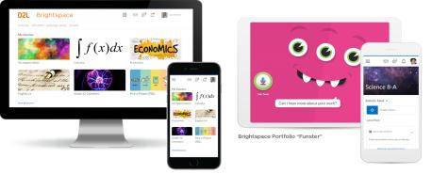
Understanding some terms...
Company:
D2L
Product:
Brightspace
Online Community:
Brightspace Community
Notes:
This is a useful slide to ensure everyone understand the terminology used when discussing Brightspace.
It would be helpful to personalize this slide to include any District specific information, especially if your District as a different branding for “Brightspace.” This will help attendees when they see resources about “Brightspace” to know that this is what your District is using as well but has branded differently.

Slide 7






One platform to collect your teaching resources
Equity for all students
Meaningful connections with students and parents
Why Educators
Brightspace
Tools teachers love
Worry-free technology
Content aligned with curriculum outcomes
Notes:
Here are some reasons Educators love using Brightspace to support their teaching
Tip: Change this up to meet the needs, values and reasons your District loves Brightspace!

Slide 8
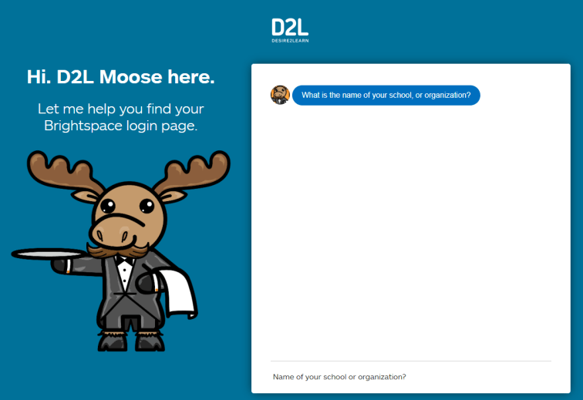
Where’s My District’s Brightspace?
https://login-finder.d2l.com/
Notes:
Use this slide to show how your educators and staff can login into Brightspace. This may include how they long on from their staff portal, what the URL is, and what login in credentials they should use. You may also consider having information for how students can access Brightspace.

Slide 9
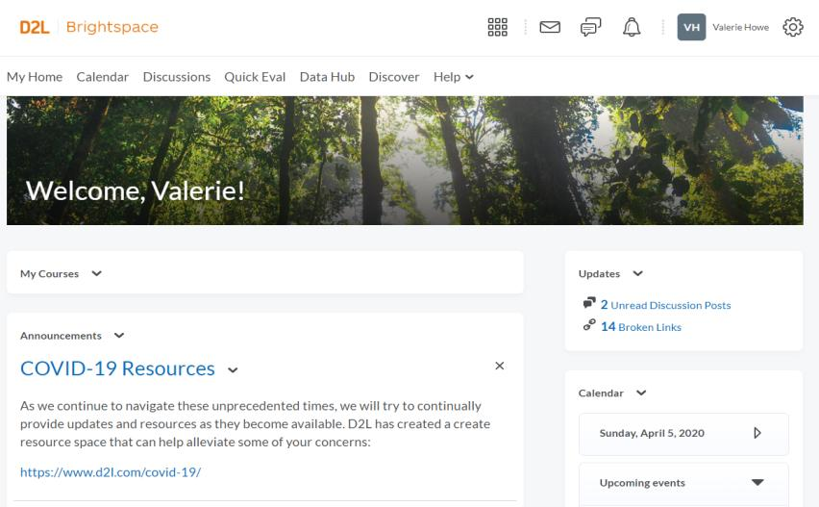
Homepage Overview
Mini-Bar
Navbar
Widgets
Notes:
Before we head into our District environment, I want to take a moment to discuss some useful terminology when navigating Brightspace
Mini-Bar: The mini-bar sits in the upper right-hand corner and is where you will find your Course Selector (also sometimes called “the Waffle,” communication alerts, notifications and updates, and account information and settings
Navbar: Your Navigation Bar (more commonly known as a Navbar) is where you can easily access tools and resources in Brightspace. Your Navbar will change depending on where you are in the system (i.e. your District’s Org Level Homepages vs different Courses)
Widgets: A tech term for something that provides information! There are many different widgets available, and your District may have created their own Widgets as well. The Widgets are the white boxes that you will see on Homepages

Slide 10
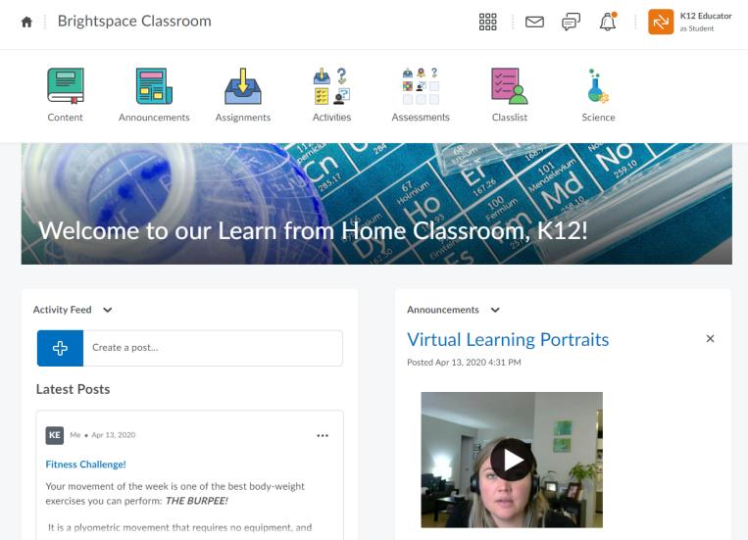

What’s on the Course Homepage?
Return to Homepage
Return to Course Homepage
Nav Bar
1
2
3
4
Waffle
List of all your courses
Email
Chat
Notifications
Notes:
Mini-Bar: The mini-bar sits in the upper right-hand corner and is where you will find your Course Selector (also sometimes called “the Waffle,” communication alerts, notifications and updates, and account information and settings
Navbar: Your Navigation Bar (more commonly known as a Navbar) is where you can easily access tools and resources in Brightspace. Your Navbar will change depending on where you are in the system (i.e. your District’s Org Level Homepages vs different Courses)
Widgets: A tech term for something that provides information! There are many different widgets available, and your District may have created their own Widgets as well. The Widgets are the white boxes that you will see on Homepages

Slide 11
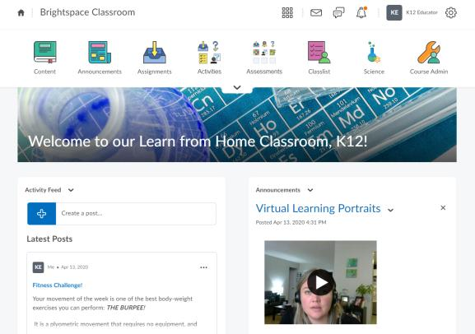
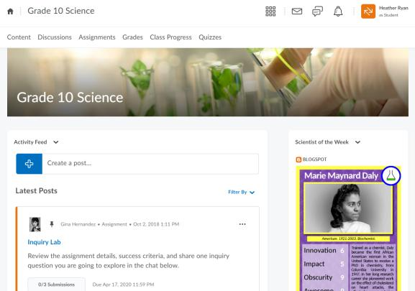
Examples of Course Homepages
** Course homepages may look different depending on how your District has configured Brightspace. **
Notes:
We recommend you personalize this slide to include examples from your own District that will appeal to the demographic of your webinar audience (i.e., Elementary vs Secondary, Science educators vs Second Language educators)
This slide is to highlight that Brightspace is very customizable and different courses might be configured differently or customized to meet the needs of learners for that course

Slide 12
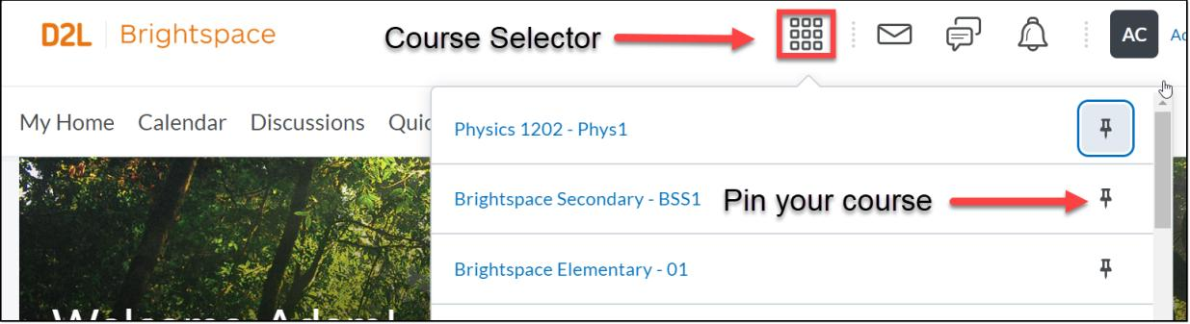
Find your course
Notes:
This slide can serve as a resource for your educators & staff after the webinar. It can also serve to help with step by steps instructions if doing a live demo is not possible.
Another option is to let your attendees know these how-to slides are in the slide deck for them to reference, and hide the remaining slides during the live webinar, and unhide them prior to send the slide deck to your attendees after the webinar.

Slide 13
Getting Started
Demo
Learning Objectives:
You will be able to:
  Customize your homepage banner
  Use replace strings
  Create a rich Announcement using “Insert Stuff”
  Create interactive Activity Feed posts
  Preview as a student
Notes:
Next we’ll head into a live demo to show you how you can get started with Brightspace
Note: The learning objectives on this slide can be personalized to meet the needs for your District and attendees

Slide 14
Announcements vs. Activity Feed
Announcements | Activity Feed
Create a rich message with links and videos embedded within Posts can be copied into another course Use Video Note | Quickly create a message Allow students to comment on your posts Integrate the assignment folder directly in your post
Notes:
This slide can serve as a resource for your educators & staff after the webinar. It can also serve to help with step by steps instructions if doing a live demo is not possible.
Another option is to let your attendees know these how-to slides are in the slide deck for them to reference, and hide the remaining slides during the live webinar, and unhide them prior to send the slide deck to your attendees after the webinar.

Slide 15
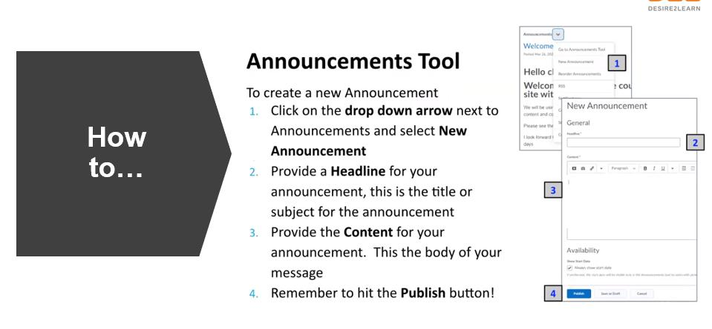
Notes:
This slide can serve as a resource for your educators & staff after the webinar. It can also serve to help with step by steps instructions if doing a live demo is not possible.
Another option is to let your attendees know these how-to slides are in the slide deck for them to reference, and hide the remaining slides during the live webinar, and unhide them prior to send the slide deck to your attendees after the webinar.

Slide 16
What Do I See on the HTML Editor?
1. 2. 3. 4. 5. 6. 7. 8.
9. 10.
11.
Text editing options
Add Image
Insert Stuff
Add Links
Equation Editor
Bulleting options
Table options
Font formatting options
Accessibilty Checker
Preview
Full Screen
Notes:
This slide can serve as a resource for your educators & staff after the webinar. It can also serve to help with step by steps instructions if doing a live demo is not possible.
Another option is to let your attendees know these how-to slides are in the slide deck for them to reference, and hide the remaining slides during the live webinar, and unhide them prior to send the slide deck to your attendees after the webinar.

Slide 17
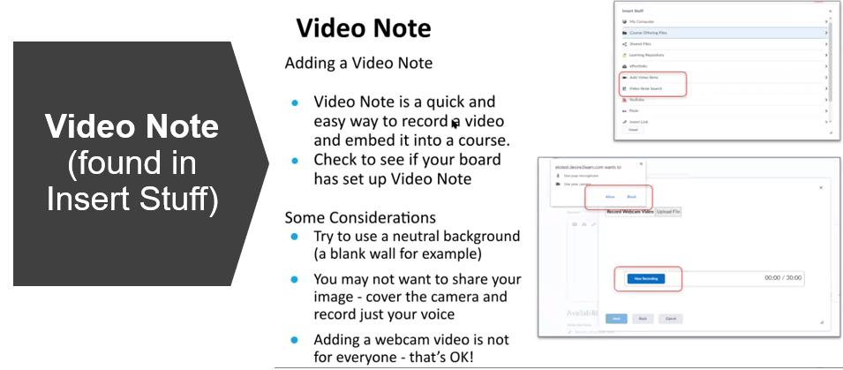
Notes:
This slide can serve as a resource for your educators & staff after the webinar. It can also serve to help with step by steps instructions if doing a live demo is not possible.
Another option is to let your attendees know these how-to slides are in the slide deck for them to reference, and hide the remaining slides during the live webinar, and unhide them prior to send the slide deck to your attendees after the webinar.

Slide 18
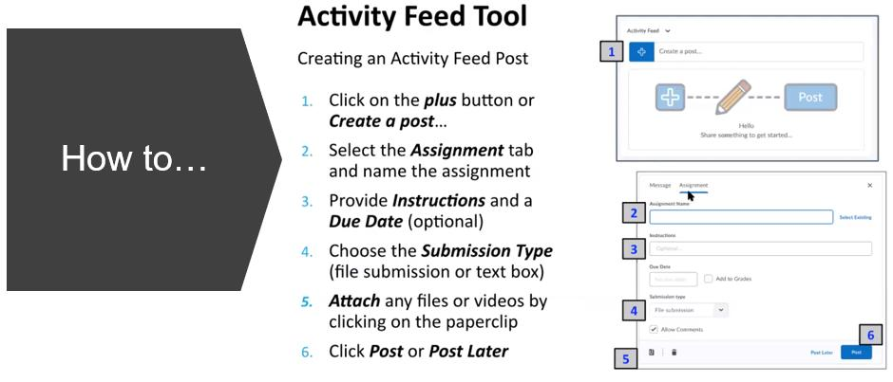
Notes:
This slide can serve as a resource for your educators & staff after the webinar. It can also serve to help with step by steps instructions if doing a live demo is not possible.
Another option is to let your attendees know these how-to slides are in the slide deck for them to reference, and hide the remaining slides during the live webinar, and unhide them prior to send the slide deck to your attendees after the webinar.

Slide 19
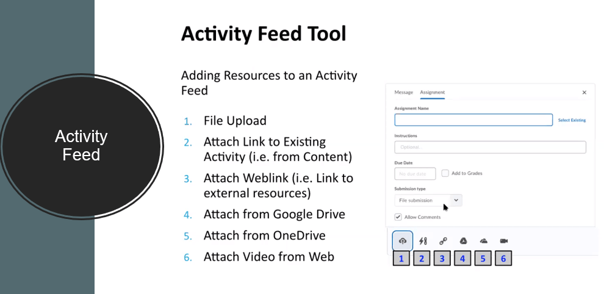
Notes:
This slide can serve as a resource for your educators & staff after the webinar. It can also serve to help with step by steps instructions if doing a live demo is not possible.
Another option is to let your attendees know these how-to slides are in the slide deck for them to reference, and hide the remaining slides during the live webinar, and unhide them prior to send the slide deck to your attendees after the webinar.

Slide 20
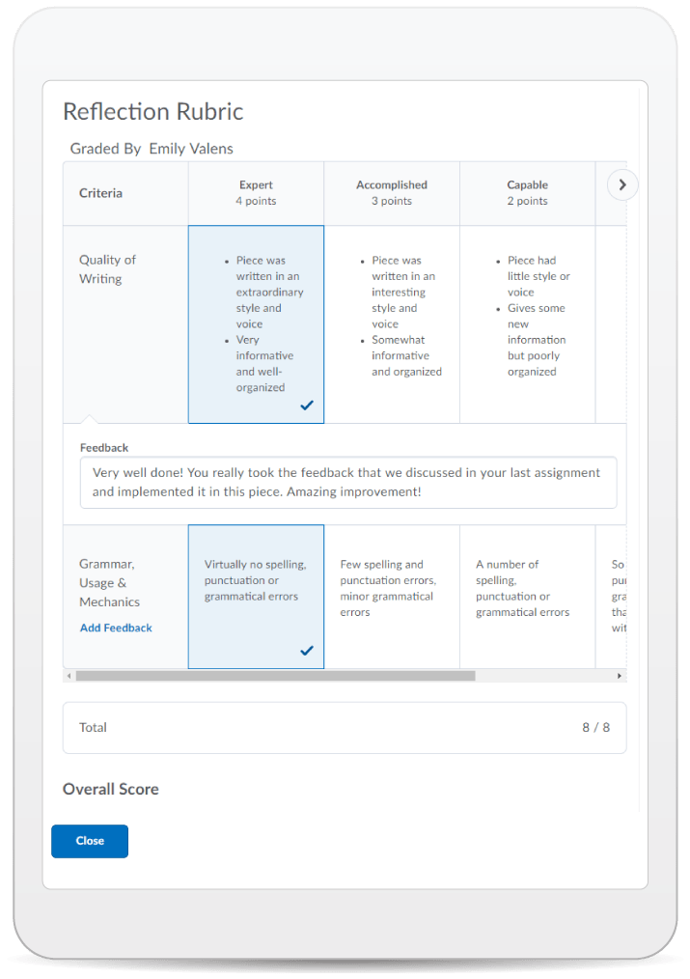
Learning Objectives:
You learned how to:
  Customize your homepage banner
  Use replace strings
  Create a rich Announcement using “Insert Stuff”
  Create interactive Activity Feed posts
  Preview as a student
© 2020 D2L Corporation

Slide 21
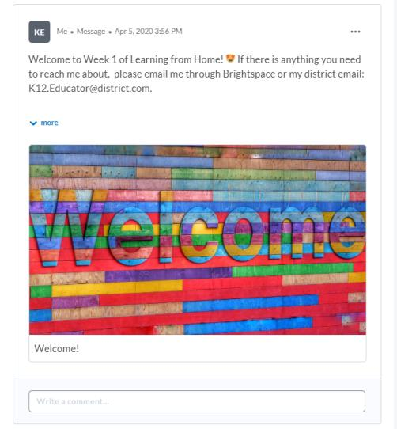
Give This a Try!
Create a multi-media Announcement using the HTML editor to "Insert Stuff" - try adding a Video Note, an image, embed another webpage, and add a YouTube video.
Create an Activity Feed message to engage in a conversation with your students. Try scheduling it for next week.

Slide 22
Resources
Brightspace Quick Start Guide K-12
D2L Parent and Guardian Support Site
D2L One Minute Workflow Videos
D2L Educator Webinar Archive
Notes:
This page has resources specifically on how to Get Started with Brightspace. This is also where District specific resources can be added.

Slide 23
Tutorial Videos
Communication and Collaboration | Organizing Course Materials | Documenting Student Learning | Feedback & Assessment
Announcements Activity Feed -Add Attachments and Links to Posts -Create an Assignment Post in Activity Feed -Customize Notifications for Activity Feed -For posting a message -Optimize Activity Feed Discussions | Content/Lessons Tool -Getting Started with Lessons for Instructors -Lessons: Add a New Unit and Lesson -Lessons: Add New Materials -Lessons: Reorder Units, Lessons, Folders, and Materials -Lessons: Attach a Release Condition Groups -Creating Groups -Creating Individual Student Groups -Creating Unique Learner Pathways | Brightspace Portfolio -Review and Approve Portfolio Items -Oversee and View Individual Portfolios -Brightspace Portfolio: Bring Your Own Device (for learners) -Portfolio AT HOME Assignments Discussions Quizzes -Quiz Question Converter | Rubrics -Create an Analytic Rubric -Create a Holistic Rubric Grades -Entering Grades -Associate an Activity with a Grade Item -Create a Grade Scheme Standards/Expectations -Standards: Import Standards from Course Admin Assessing or Evaluating Against Expectations Quick Eval
Notes:
There are also many quick tutorial videos available! These resources are organized pedagogically. Every underlined item is linked to a tutorial video

Slide 24
Thank you!
@Twitterhandle
#districthashtag
#D2LK12
Notes:
Thank you so much for joining us today!
If you have any questions or need any help, please consult or contact:
We’d love to see all the awesome ways you’re using Brightspace! Use our District hashtag and/or #D2LK12 so we can all learn from each other and share great ideas of how to use Brightspace to support teaching, learning and, most importantly, our students!

