Slide 1
Hi Presenter! Read Me Before Using!
This webinar resource is almost ready for you to use! Be sure to:
Look through and add custom information
Slide 2- Title slide (date)
Slide 3- Presenter information
Slide 5- Housekeeping items
Slide 14-15 Demo Site QR Code Screen Shots (optional)
Slide 16 - 17 – District Specific Examples (optional)
Slide 22 – 23 – Edit to reflect audience (optional)
Slide 27 - Resources (optional)
Slide 28 - Thank you slide
There are presenter notes to help guide you- feel free to edit these
This resource can be customized. Here are some examples of how you can personalize this slide deck to suit the needs of your educators and staff:
Replace our images with screen shots from your environment
Read through slides and ensure terms and jargon will resonate with your board policies/ tool names in your Brightspace environment (i.e. Assignments vs Dropbox, Announcements vs News)
Add additional information to slides specific to your district, including how this helps meet district goals, improvements plans, strategic plans etc
Include your district logo on slides or change the colors used to match your district branding

Slide 2
Documenting Student Learning with Portfolio
<insert date>
© 2020 D2L Corporation

Slide 3
Presenter Name Title Company/Organization
@Twitter handle

Slide 4
Agenda
Housekeeping
What is Brightspace?
Why use Portfolio?
Develop an understanding of Portfolio and be able to navigate as well as manage and configure settings to personalize your classroom

Slide 5
Housekeeping Items
How can people ask questions?
Webinar recording and slide deck will be available on ___________
Information about attendance
Notes:
This slide is for you to add Housekeeping Items particular to your District and this session.
It may include information about how attendees can ask questions, how they can access the webinar information after the session, or even how they confirm their attendance for the session (if applicable)

Slide 6
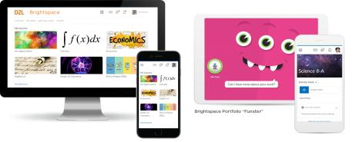
Understanding some terms...
Company:
D2L
Product:
Brightspace
Online Community:
Brightspace Community
Notes:
This is a useful slide to ensure everyone understand the terminology used when discussing Brightspace.
It would be helpful to personalize this slide to include any District specific information, especially if your District as a different branding for “Brightspace.” This will help attendees when they see resources about “Brightspace” to know that this is what your District is using as well but has branded differently.

Slide 7
One platform to collect your teaching resources
Equity for all students
Meaningful connections with students and parents
Why Educators
Brightspace
Tools teachers love
Worry-free technology
Content aligned with curriculum outcomes
Notes:
Here are some reasons Educators love using Brightspace to support their teaching
Tip: Change this up to meet the needs, values and reasons your District loves Brightspace!

Slide 8
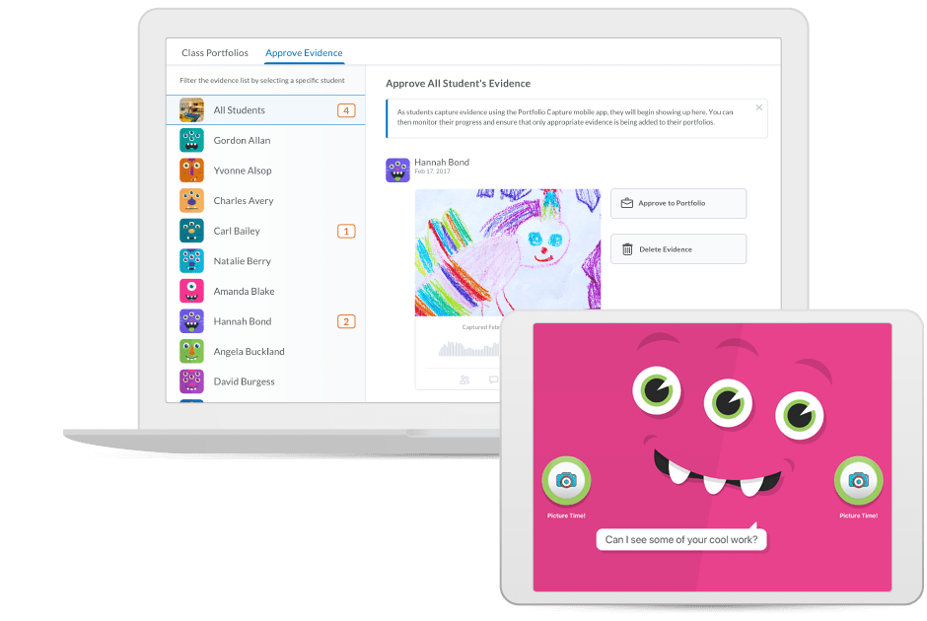
Brightspace Portfolio
A tool that allows learners to collect evidence of their learning in the classroom and at home
Learners can attach written, audio, and video reflections on their work
Teachers can easily review, approve, provide feedback, and share with parents.
Notes:
Portfolio is a great way for students to capture evidence of their learning and add reflections with little assistance from teachers. It’s easy to teachers to review and approve portfolio items, and then share them with the student’s parents or guardians.
With Portfolio, it’s easy for young students to share what they have learned. · Blended classrooms can use a shared device – each student can identify themselves using a pass card · A friendly monster guides students through the process of using the portfolio, and even reminds them to ‘hold still’ when taking a picture · Students can upload pictures and audio reflections with an easy-to-use interface that was designed for non-readers. Photos can be retaken if they don’t turn out the first time. · Documents can be uploaded from Google Drive and written reflections can be added when students are older With a simple workflow, teachers can review, approve and provide feedback on portfolio items. · Teachers can easily review, and approve portfolio items · Teachers can categorize portfolio items · Teachers can provide feedback to students · Little to no setup for teachers ca share portfolio items with their student’s parents · Teachers can easily share portfolio items with parents · Teachers can share a student’s entire portfolio with parents, which is useful during interviews

Slide 9
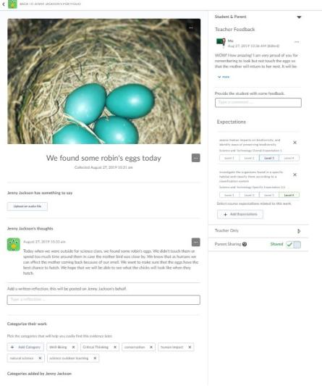
Why Use Portfolio?
Secure and private data
Audio prompt for reflection
Student-centered: empowers students
Provide timely, transparent feedback
Private comment space for educators
One-click sharing with parents
Portfolio travels with the student year over year

Slide 10
Portfolio Instructional Demo
Learning Objectives:
You will learn:
How to navigate the options in the app
How to manage and configure your settings
How to navigate the teacher experience
How to approve evidence of learning
How to provide feedback and use the search categories

Slide 11
The Technology and the Tools
Brightspace’s Portfolio App is available on Apple and Android mobile devices
Have you downloaded it yet?

Slide 12
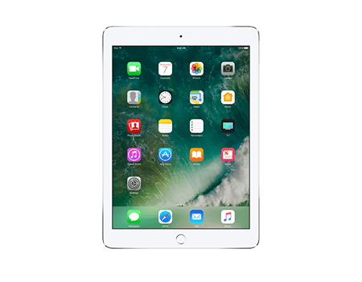
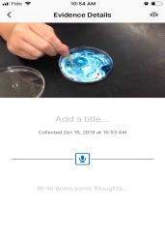
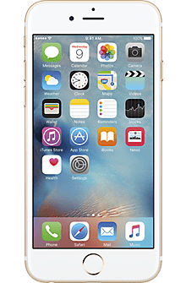
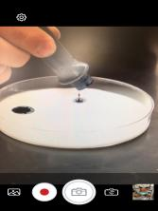
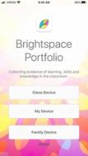
4 Ways For Students To Access:
Use the App
Use a Web Browser
1. Class Device
Shared device used in the classroom
2. My Device
For students who have their own mobile device
3. Family Device
Shared device, used at home, offers Funster option
4. Web Experience
Option to log in from a computer/laptop/browser

Slide 13
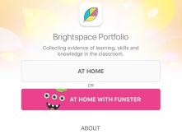
Student Login Info: The App
1. In Class with Funster
QR Codes
2. In Class Mode
QR Codes
3. At Home Mode
QR Codes
4. My Device
Web site URL + login credentials

Slide 14
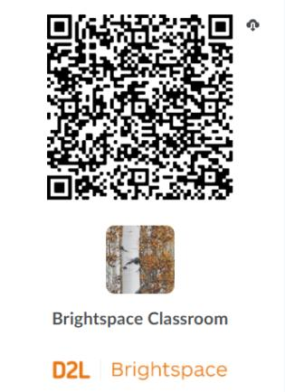
Course QR Code
The course QR code opens
your class/course.
Scanning it only has
to happen when you first launch
the application on your device.
Example:

Slide 15
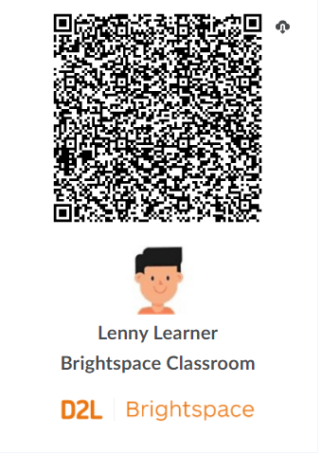
Student QR Code
Each student enrolled in your
class is automatically generated
a unique QR code.
QR codes act as their Portfolio
login and password.
Reminder: Student QR Codes contain private login information for students, proper precautions should be taken. QR codes should never be displayed online in public forums (ex. social media)
Example:

Slide 16
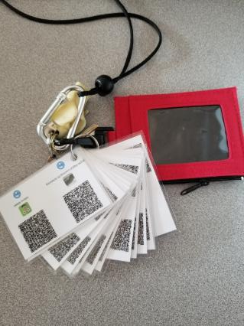
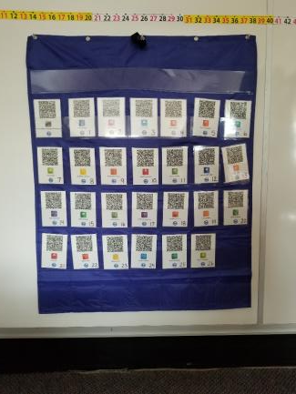
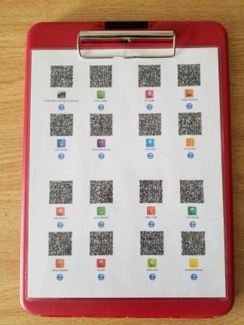
QR Codes Best Practice for the Classroom
On the Move in Class: Easy to share between support teachers in the classroom: Supply, Planning Cover, ECEs, EAs…
On your person: MOBILE, always with you for quick reference and ON THE GO documentation
On the Wall: permanent reference for student use and independence. Tip: Use student numbers for easy identification and order
Examples from St. Jacobs Public School (Waterloo Region District School Board, Ontario, Canada)

Slide 17
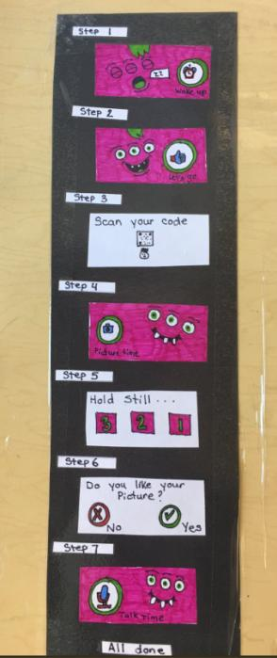
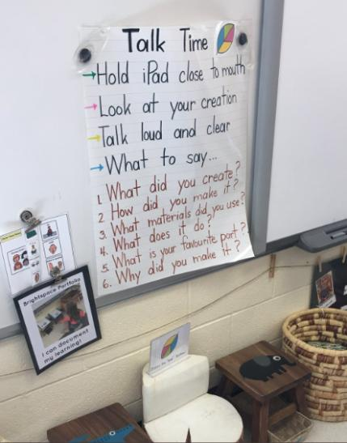
Best Practices for the Classroom
Enable your students to use Portfolio themselves by providing them with some instructions and steps so they can explore their own learning.
Here are some examples from kindergarten classrooms from Simcoe County District School Board (Ontario, Canada)

Slide 18
Student Demo of the Brightspace Portfolio App

Slide 19
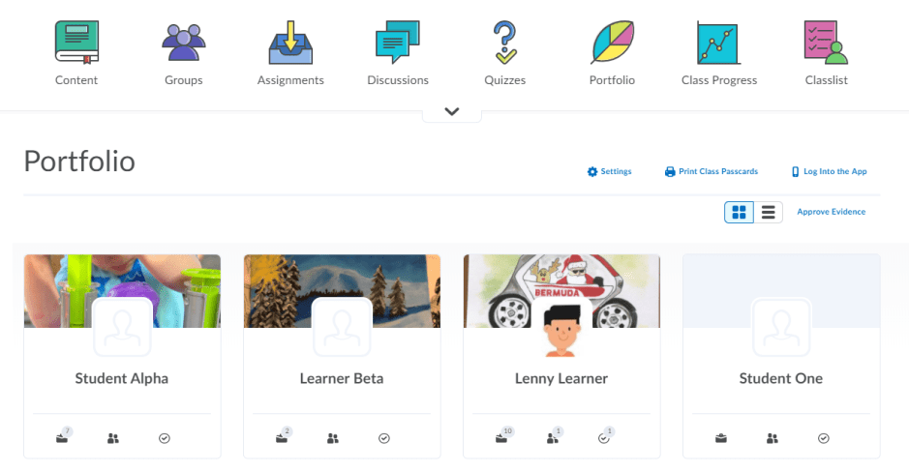
What do I see in Portfolio?
1
Legend:
NavBar Icon
Settings
Print Class Passcards
View Options
Approve Evidence
Student Portfolio
Approved Evidence
Evidence Shared with Parents
Unapproved Evidence
2
3
6
4
5
7
8
9

Slide 20
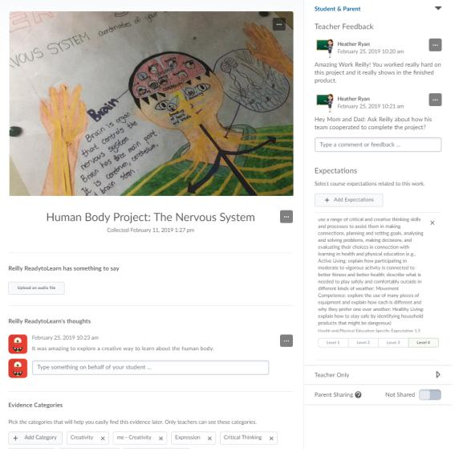
Portfolio Web Experience – Teacher
View student artifacts
Listen to audio reflection and read written reflections
Record student reflections on their behalf
Share with parents
Add feedback
Tag with evidence categories
Align and evaluate curriculum standards
Add private teacher only comments

Slide 21
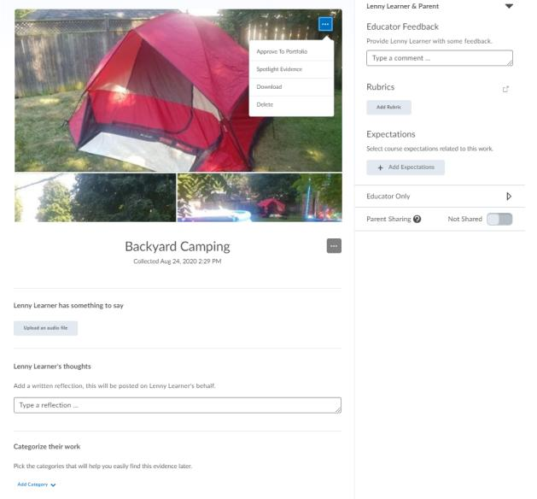
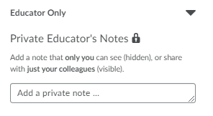
What can I do when I Approve Evidence?
Provide feedback and next steps to students
Image editing options
Assess using rubrics and against learning expectations or curriculum standards
One-click sharing to Brightspace for Parents
Listen to audio reflections recorded by the student, upload new audio file
Add written reflection on behalf of a student, edit text added by a student
Categorize student work, edit categories added

Slide 22
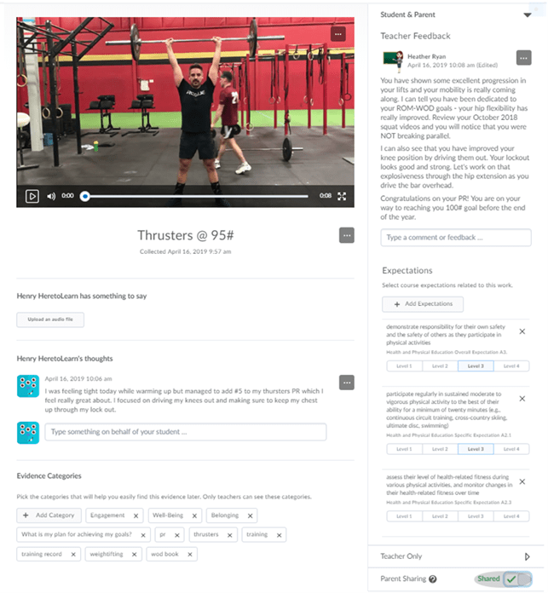
Examples of Portfolio in Secondary
Field Trips
Authentic student reflection, voice and engagement
Outdoor Lessons
Documenting learning anywhere
Oral and Music Assessments
Free up in-class time
Progression of skills
Physical Education
Documenting milestones
Capturing learning
Art
Tracking progress and development of projects
Co-Op
Restatement and demonstration of learning

Slide 23
Ideas for Using Portfolio…
“Guarding your Garden” – monitoring a green space and tracking growth, science
Scavenger Hunts – numeracy and literacy, finding things in groups of a certain number, finding certain shapes in their home/outside. Use Portfolio to find something that starts with a letter, demonstrate pattern building, counting…the options are endless!!
Teachers sends out sight words and students post a picture using the words (making a sentence, acting something out)
Reading – teachers ask students to post a picture of them with the book they read they read that day and have students retell, talk about their favorite part, etc.
Literacy – read aloud practice, student videos themselves reading from a book (also works for FSL in older grades)
Digital book report – giving analysis tasks and the students respond via Portfolio
Virtual Journals – chance for students to connect with their teacher
Daily Physical Activity – teachers requesting student to try different activities. Ex. Yoga Move of the Day – teacher posted pictures of kid-friendly yoga poses and students try it and document in Portfolio
Phys Ed – can track progress with weightlifting, form checks, goals

Slide 24
…More Ideas for Using Portfolio
Gratitude Posters– students make a poster of why they are thankful for frontline workers / community helpers. They can hang the art in their window and, in their reflection, they can discuss why they are thankful
“What things did you help with at home today?” – Students post to their portfolio something they helped with (cooking, baking, cleaning, etc.)
Directed drawing videos on YouTube – post the directive drawing on Activity Feed and have students upload their final product to Portfolio (reflection could be how they felt about it, was it easy, hard? What else would they want to draw). Could also use discussions for this if you want the students to be able to see all the other students’ work
Virtual Learning Portraits – students create virtual learning portraits inspired by an artist. Great example: artist Gregg Segal’s Daily Bread series. Students should include items that have been most important to them while they are learning from home
Documentation of Accommodations: students can upload a picture/video of a task they’ve performed that fits their accommodations

Slide 25
Learning Objectives
Give it a try!
Learning Objectives:
Today you learned:
How to navigate the options in the app
How to manage and configure your settings
How to navigate the teacher experience
How to provide feedback and use the search categories

Slide 26
Resources
Brightspace Quick Start Guide K-12
D2L Parent and Guardian Support Site
D2L One Minute Workflow Videos
D2L Educator Webinar Archive
Notes:
This page has resources specifically on how to Get Started with Brightspace. This is also where District specific resources can be added.

Slide 27
Tutorial Videos
Communication and Collaboration | Organizing Course Materials | Documenting Student Learning | Feedback & Assessment
Announcements Activity Feed -Add Attachments and Links to Posts -Create an Assignment Post in Activity Feed -Customize Notifications for Activity Feed -For posting a message -Optimize Activity Feed Discussions | Content/Lessons Tool -Getting Started with Lessons for Instructors -Lessons: Add a New Unit and Lesson -Lessons: Add New Materials -Lessons: Reorder Units, Lessons, Folders, and Materials -Lessons: Attach a Release Condition Groups -Creating Groups -Creating Individual Student Groups -Creating Unique Learner Pathways | Brightspace Portfolio -Review and Approve Portfolio Items -Oversee and View Individual Portfolios -Brightspace Portfolio: Bring Your Own Device (for learners) -Portfolio AT HOME Assignments Discussions Quizzes -Quiz Question Converter | Rubrics -Create an Analytic Rubric -Create a Holistic Rubric Grades -Entering Grades -Associate an Activity with a Grade Item -Create a Grade Scheme Standards/Expectations -Standards: Import Standards from Course Admin Assessing or Evaluating Against Expectations Quick Eval
Notes:
There are also many quick tutorial videos available! These resources are organized pedagogically. Every underlined item is linked to a tutorial video

Slide 28
Thank you!
@Twitterhandle
#districthashtag
#D2LK12
Notes:
Thank you so much for joining us today!
If you have any questions or need any help, please consult or contact:
We’d love to see all the awesome ways you’re using Brightspace! Use our District hashtag and/or #D2LK12 so we can all learn from each other and share great ideas of how to use Brightspace to support teaching, learning and, most importantly, our students!

